Slide 1
Bulk Adding 20+ Users From A .CSV File
By: Ronnie Kupfer

Slide 2
INTRODUCTION
This project presents how to “bulk add” multiple users to an Active Directory domain from a .CSV file using a PowerShell Script.
Bulk add at least 20 users into your Active Directory (AD) domain using a .CSV file and PowerShell.
Demonstrate that you can also export these users into a .CSV file.
Use a domain that has your name or demonstrates that you created the .CSV file for your domain.
Add users to a specific Organizational Unit (OU).
Set a login script for each user with a minimum of mouse clicks.
Set the user passwords to a unique password for each user with a script.

Slide 3
PROJECT OUTLINE
Organize a spreadsheet of users with their applicable user information into a clear visual presentation of the users.
Convert the spreadsheet into a .CSV file.
Obtain/write/improve a PowerShell script that will take the .CSV data and write them to the Active Directory domain as users.
Run the PowerShell script and create the users.
Apply a login script to the new users with a minimal of mouse clicks.
Use a script to export the users in an Active Directory domain to a .CSV file.

Slide 4
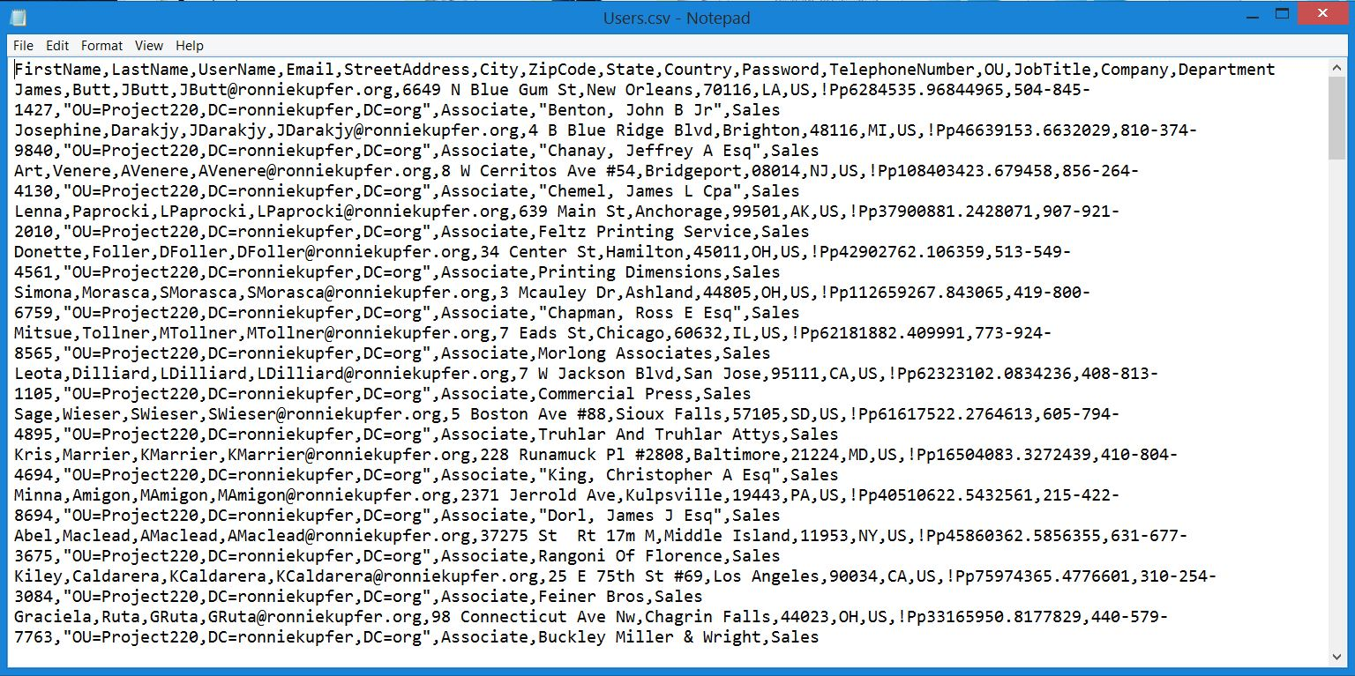
HOW TO MAKE A .CSV FILE OF AD USERS
What is a .CSV file? Simply a .CSV file is a comma separated values file. This is a text file in which each line contains all the user data whose parameter values are separated by commas. A .CSV file looks like this:

Slide 5
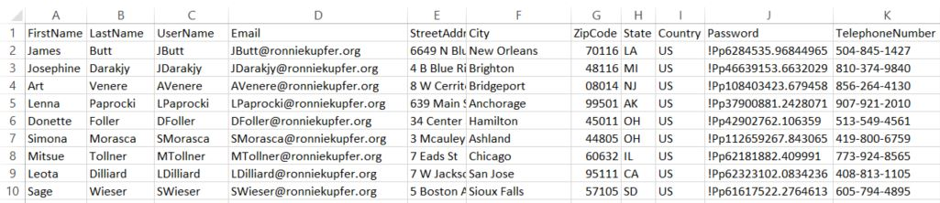
HOW TO MAKE A .CSV FILE OF AD USERS
The first line of .CSV files may or may not contain a “header row.”
This is a row that defines what each parameter is if you were to align the data into columns.
For the process of bulk loading users into active directory, the .CSV file will have a “header row” that will define the parameter values.
This is the first row that Excel will display as a .CSV file as interpreted by Excel.
Excel interprets the .CSV file in the previous slide like this:

Slide 6
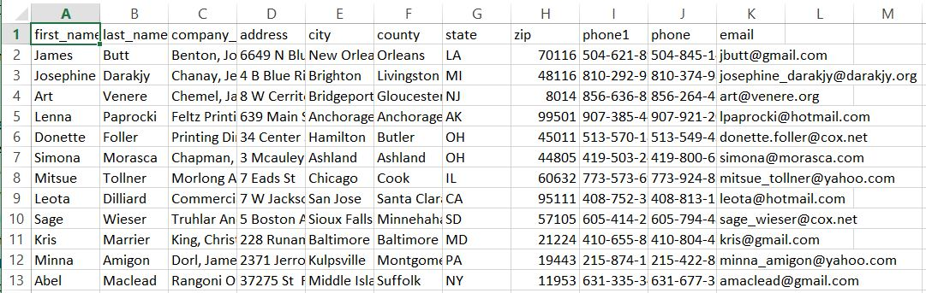
HOW TO MAKE A .CSV FILE OF AD USERS
Note: There is little difference between the presentation of an Excel spreadsheet of .XLSX format (the XML backed file format of an Excel spreadsheet) and a .CSV file being presented by Excel. The difference is that there is formatting that can be lost when saving a file as a .CSV file. The steps shown in this project are the same when working in either an .XLSX file in Excel or a .CSV file in Excel.
In this project, the source file is converted from this:

Slide 7
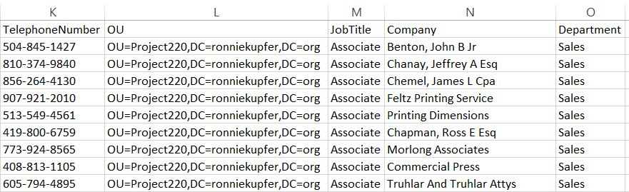
HOW TO MAKE A .CSV FILE OF AD USERS
To a .CSV file that looks like this:

Slide 8
HOW TO MAKE A .CSV FILE OF AD USERS
Organize the columns and setting the header names as shown in the previous slide.
Format of the ZipCode column to show the leading zero(s).
Highlight the column with the zipcode data.
Click on the dialog launcher next to the number format ribbon group.
Click on the Number tab of the Format Cells box.
Select Custom in the Category box.
Type five zeroes in the Type: field.
A tip for selecting all the data down a column starting with the cell you’ve highlighted - After selecting your starting cell, press CTRL + SHIFT + DOWN ARROW.
The following slide shows this process.

Slide 9
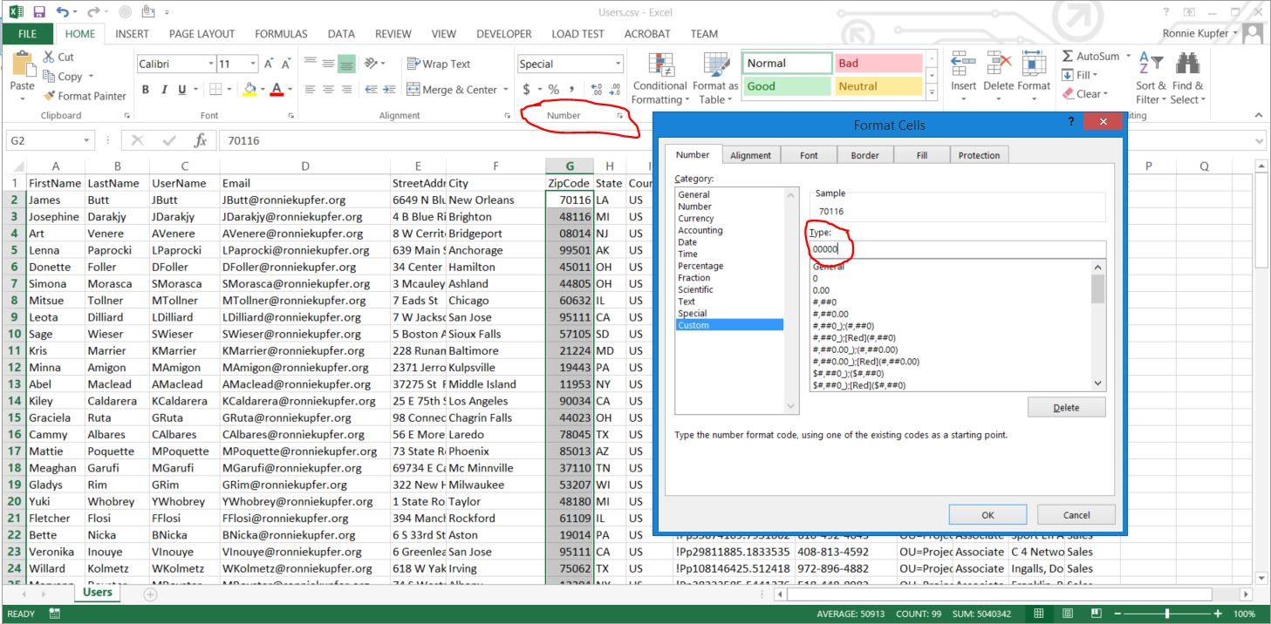
HOW TO MAKE A .CSV FILE OF AD USERS

Slide 10
HOW TO MAKE A .CSV FILE OF AD USERS
Populate the country column with the United States.
AD looks for a country code.
The correct country code for the United States is US.
Generate a random password in Excel.
Use the RAND (random) function in Excel.
RAND returns a random number between 0 and 1.
Multiply the decimal returned by RAND() by 123456789 to generate a random number that exceeds minimum password length requirements.
Concatenate the random number with !Pp. This applies the capitol letter requirement, the lowercase letter requirement, and the special character requirement. Note that because the random number is a decimal, if you leave the decimal in the password, you will meet the special character requirement.
Use the following formula to perform the concatenation and random number generation: =P2&(Q2*RAND())
Double click the fill handle of these three cells to fill in all the rows which have users.
The following slide shows how this was done.

Slide 11
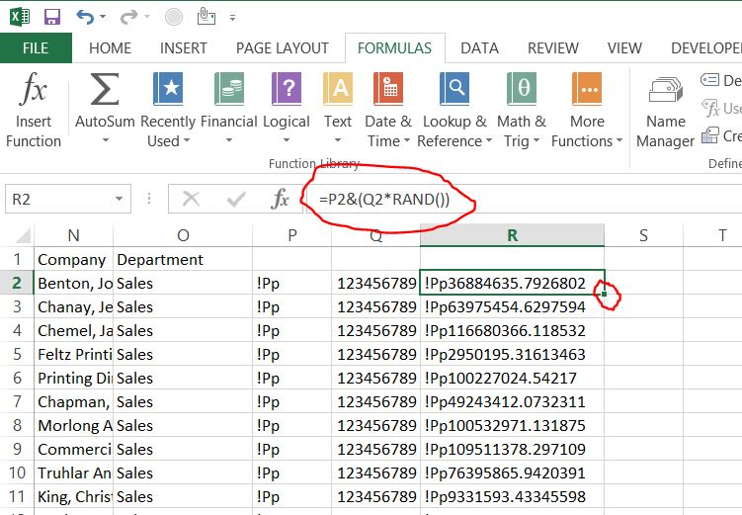
HOW TO MAKE A .CSV FILE OF AD USERS

Slide 12
HOW TO MAKE A .CSV FILE OF AD USERS
Notes on the password generation:
The & symbol performs concatenation of two cells. In this case it tells cell R2 to combine the data in cell P2 with the product of cell Q2 and a random number (between 0 and 1).
The cell letter (column letter) will vary depending on where you choose to do your work.
The random passwords must be copied to the password column. The way that they are copied to the column is important.
Select all the passwords (CTRL + SHIFT + DOWN ARROW)
Copy them.
Select PASTE > VALUES in the Password column. If PASTE > VALUES is not selected, when you delete the source data in the other columns, your passwords will be lost.
Delete the source data in the right three columns.

Slide 13
HOW TO MAKE A .CSV FILE OF AD USERS
Generating usernames: The UserName convention in AD is to use the first letter of the first name concatenated with the last name.
Use the LEFT formula. The LEFT formula takes the number of characters you specify from the left side of the data in the cell you specify.
Use concatenation.
Type the following formula: =LEFT(A2,1)&B2. This formula takes the first letter of the first name (cell A2) and concatenates it with the last name (cell B2).
Double click the fill handle to populate each row of user data.
Copy and PASTE > VALUES all the usernames into the UserName column.
Delete the column with the formula that generated the usernames.
The next slide shows how this was done.

Slide 14
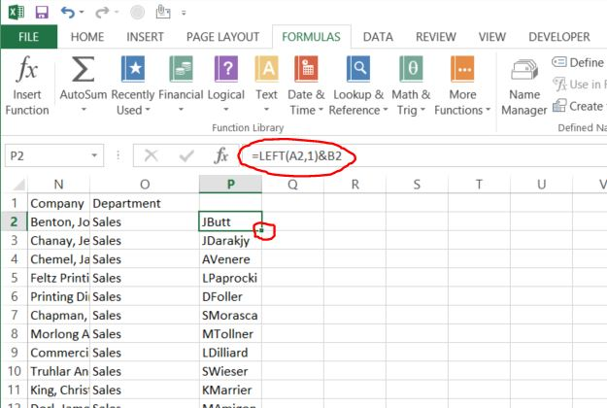
HOW TO MAKE A .CSV FILE OF AD USERS

Slide 15
HOW TO MAKE A .CSV FILE OF AD USERS
Populate the OU column.
Obtain the correct OU from your AD domain.
Right click on the OU in the management console > select properties > click on the Attribute Editor tab > scroll down to distinguished name.
Select the distinguishedName by clicking on it, then click the view button.
Copy the OU in the box that opens after clicking view.

Slide 16
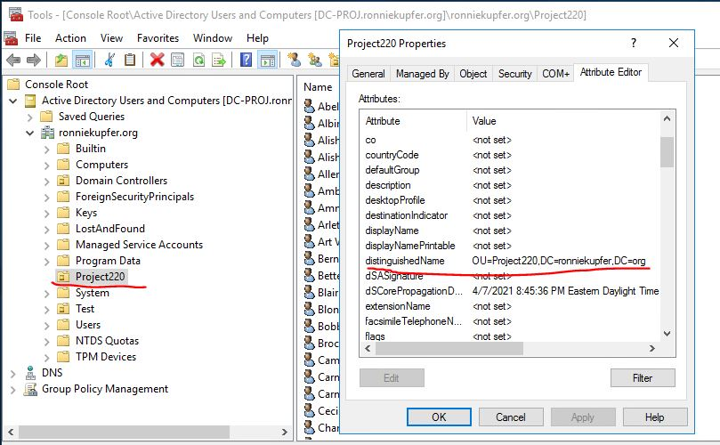
HOW TO MAKE A .CSV FILE OF AD USERS

Slide 17
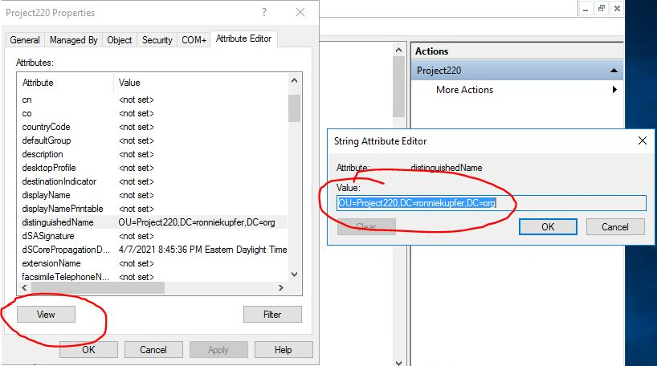
HOW TO MAKE A .CSV FILE OF AD USERS

Slide 18
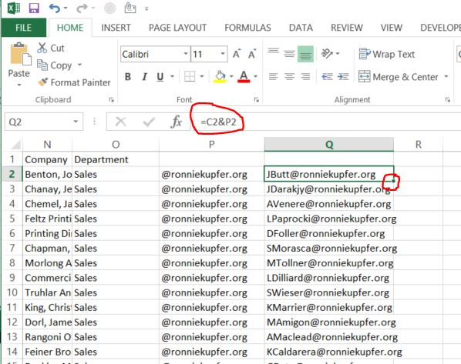
HOW TO MAKE A .CSV FILE OF AD USERS
Create the e-mail addresses. The e-mail addresses in the raw data are not the ones we would use. The e-mail addresses should be in the ronniekupfer.org domain. Fill a column with @ronniekupfer.org and concatenate the username with this in the adjacent column. Note that the column with @ronniekupfer.org must be formatted as text before typing the @ symbol.

Slide 19
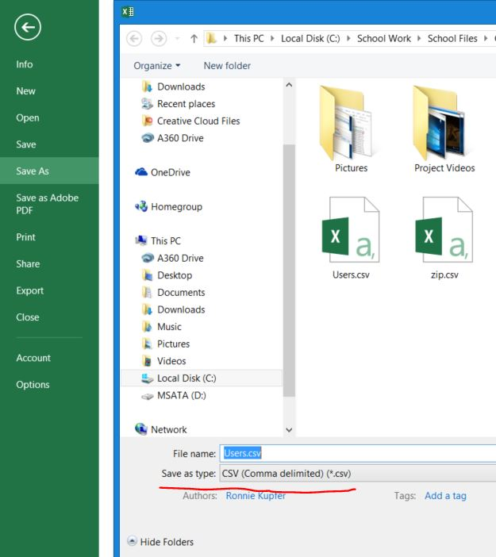
HOW TO MAKE A .CSV FILE OF AD USERS
The last step in making this file a .CSV file whether it already is one or is an Excel spreadsheet is to simply Save as type: CSV (Comma delimited) (*.csv) file as shown to the right.

Slide 20
HOW TO MAKE A .CSV FILE OF AD USERS
Below are links to two videos that show this process. The second video is a continuation of the first.
https://www.youtube.com/watch?v=4oilNlqZ1kE&t=2s
https://www.youtube.com/watch?v=Kf8wqry7uP8

Slide 21
THE POWERSHELL SCRIPT FOR BULK LOADING USERS
The PowerShell script used for bulk loading users into AD is embedded below.

Slide 22
THE POWERSHELL SCRIPT FOR BULK LOADING USERS
The # symbol in PowerShell scripts denote comments. This means the line of text following the # symbol will not be processed by PowerShell.
The $ symbol indicates that the continuous text following it is a variable.
The “Import-Module activedirectory” module allows us to use the “Import-csv” cmdlet.
The “Import-csv” reads the content of the .CSV file at the path designated and stores it in the variable $ProjectUsers.
The “Import-csv” cmdlet creates a table like structure when reading in the .CSV file into the variable $ProjectUsers. This feature also allows it to understand the first row of the .CSV file is the header file and interprets each column header name as the property name.

Slide 23
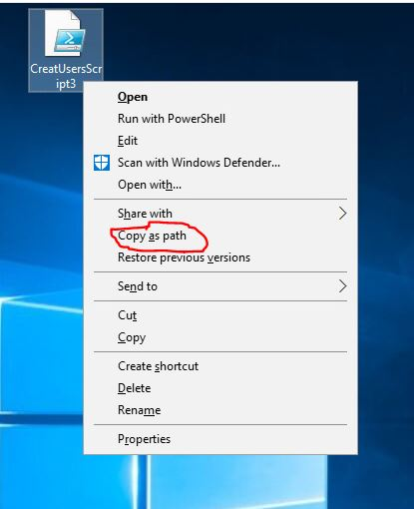
THE POWERSHELL SCRIPT FOR BULK LOADING USERS
Tip: To get the UNC path of the file location of the .CSV file (or any file), click once on the file to select it, hold the shift key and right click the file. In the menu that appears there will be an option to Copy as path.

Slide 24
THE POWERSHELL SCRIPT FOR BULK LOADING USERS
The script then uses a foreach loop (which is just a type of for loop) to read the data in the variable $ProjectUsers. It uses the variable $User to store one line of data from the .CSV file stored in $ProjectUsers. The { } symbols indicate where the foreach loop begins { and ends }. As the foreach loop reads the line of data, it stores each property in a script variable, for instance:
$Firstname = $User.FirstName
$User is the foreach loop variable.
.FirstName is the property defined in the .CSV file to contain the users first name.
The first name is now stored in the script variable $Firstname.
This means that the property names in the .CSV file can be whatever the script writer/.CSV file creator want them to be as long as the property names match in the script. As the foreach loop reads each property for one line it stores the property in its defined script variable. All of the properties read in a line define an AD User.

Slide 25
THE POWERSHELL SCRIPT FOR BULK LOADING USERS
The foreach loop does not close yet, the script moves to an if statement.
The if statement “if (Get-ADUser -F {SamAccountName -eq $Username})” checks to see if the user already exists in the domain.
The -F command is shorthand for Filter and is filtering for on all the SamAccountName(s).
The -eq performs a string comparison between $Username and the SamAccountName. If it finds a SamAccountName that exists, it generates warning and does not write the user account.
If the If statement does not find an existing user, the “New-ADUser” cmdlet is called.
The foreach loop script variable values are then assigned to the New-ADUser cmdlet parameter values that define an AD user. For instance the New-ADUser cmdlet parameter for a user’s first name is GivenName. The value of the script variable $Firstname is now assigned to the GivenName parameter of AD by the line “-GivenName $Firstname `”.
The ” ` ” (backtick) character allows the commands to be wrapped to the next line.
The ” – ” (hyphen) is used to designate a parameter, in this case a New-ADUser cmdlet parameter.

Slide 26
THE POWERSHELL SCRIPT FOR BULK LOADING USERS
The line “-AccountPassword (convertto-securestring $Password -AsPlainText -Force) -ChangePasswordAtLogon $True” assigns the value in the $Password variable to the New-ADUser cmdlet parameter and forces the user to change their password at first login.
The first user has been written to the AD domain.
The foreach loop will then read the next line of .CSV data and write the next new user to the AD domain and so on and so forth until the last line of user data is read and written.
The foreach loop has an advantage over a for loop here. The foreach loop will “understand” when the last line of data is read and will end cleanly.
In a for loop, the user must tell the loop where the last line is (how many iterations of the loop exist).

Slide 27
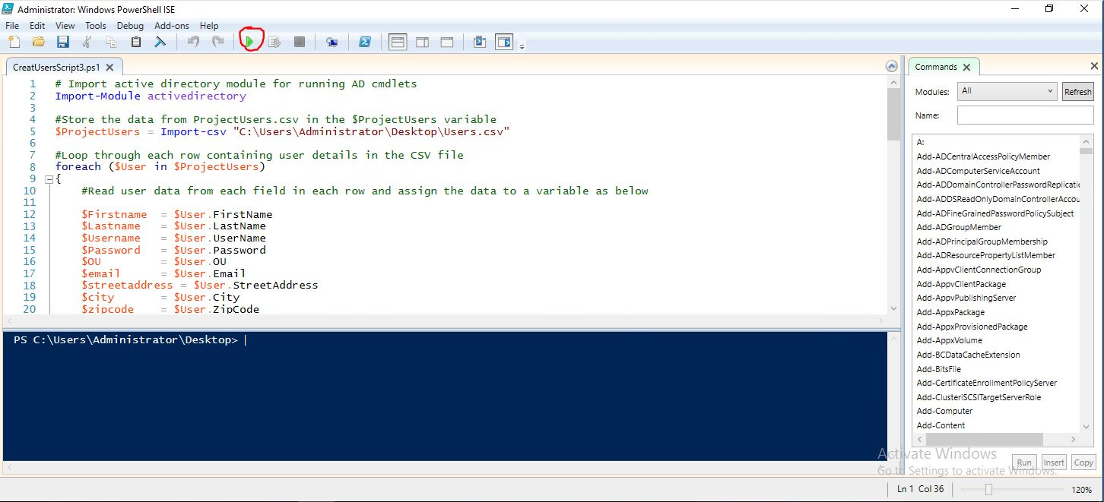
THE POWERSHELL SCRIPT FOR BULK LOADING USERS
To run the PowerShell script, right click on the script and select Run with PowerShell or Edit. Edit is used in this project and brings up the following window. This window allows you to see and edit the script. Click the green button that is circled in the image to run the script. After running the script, the users will be added to the active directory domain

Slide 28
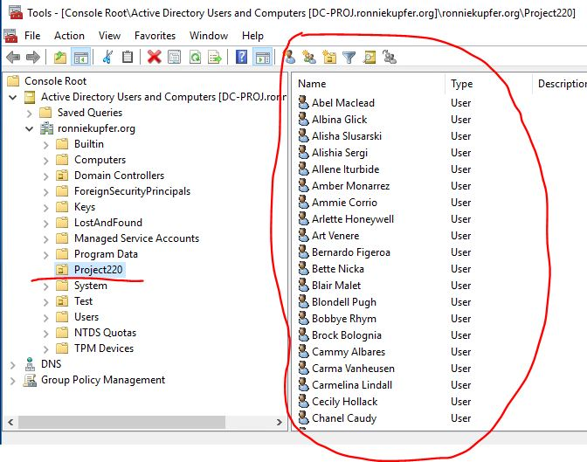
THE POWERSHELL SCRIPT FOR BULK LOADING USERS
Go to the AD Management console to verify the users have been added as below.

Slide 29
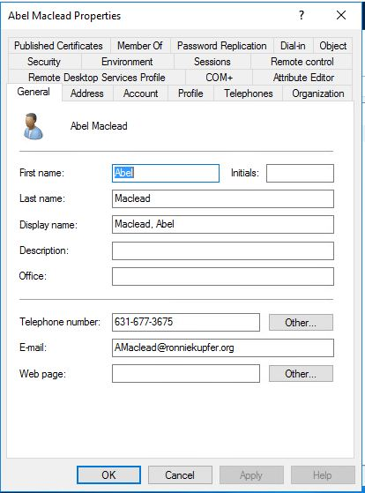
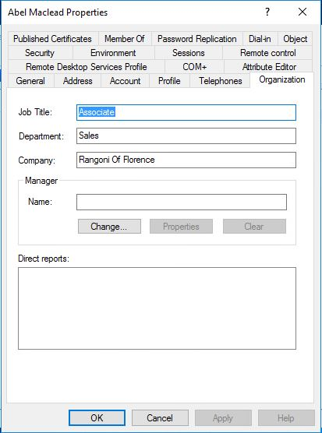
THE POWERSHELL SCRIPT FOR BULK LOADING USERS
Select a user and review their properties to make sure the script added the user data appropriately as shown in the next four images.

Slide 30
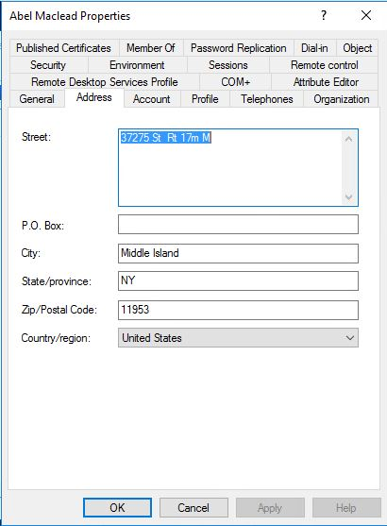
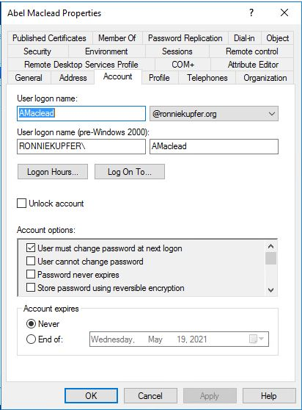
THE POWERSHELL SCRIPT FOR BULK LOADING USERS
This image shows the check box for “User must change password at next logon” has been selected as the PowerShell script designated.

Slide 31
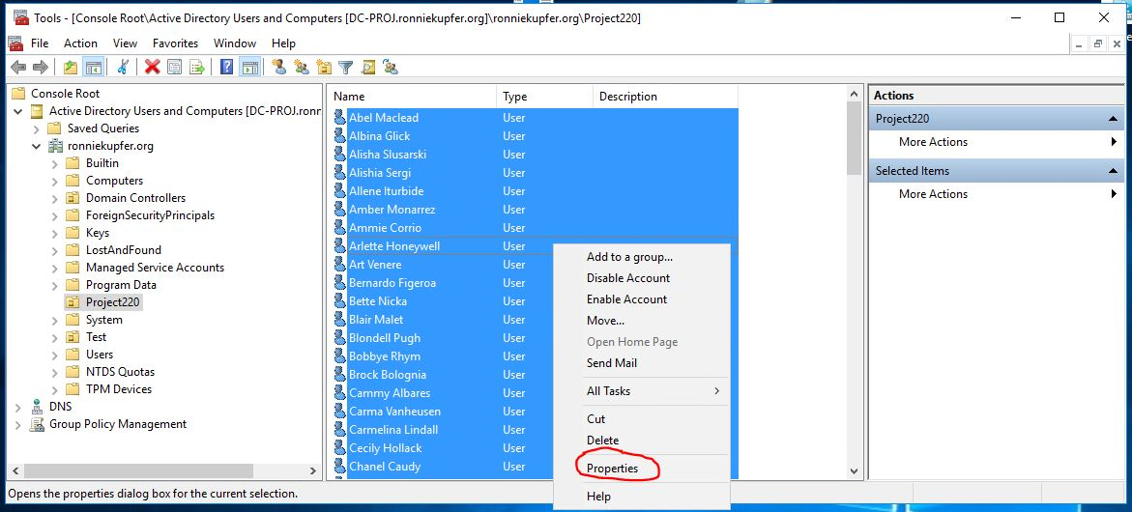
THE POWERSHELL SCRIPT FOR BULK LOADING USERS
Assigning The Login Script With Minimal Mouse Clicks
Place the login script (login.bat) on the server at the following location:
C:\Windows\SYSVOL\sysvol\ronniekupfer.org\scripts
Highlight all the new users added in the specified OU (in this case Project220) by clicking on one user and pressing CTRL + A.
Right-click on one of the users and select Properties as shown below.

Slide 32
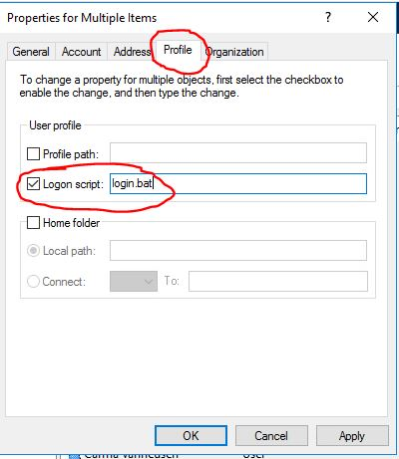
THE POWERSHELL SCRIPT FOR BULK LOADING USERS
Assigning The Login Script With Minimal Mouse Clicks
Select the Profile tab > check the Logon script: box > and type “login.bat” in the field as shown below.
Click Apply and OK and the login script will be added to all the selected users.

Slide 33
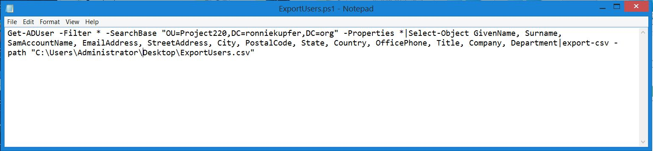
THE POWERSHELL SCRIPT FOR EXPORTING USERS OUT OF AD
The process of exporting to a .CSV file the users that are in an Active Directory domain with a PowerShell script is similar to the process of adding them with a script. The script required is much simpler however. This is what the script looks like:

Slide 34
THE POWERSHELL SCRIPT FOR EXPORTING USERS OUT OF AD
The command Get-ADUser -Filter * -SearchBase looks for all users in the specified OU.
The -Properties * command gets all the properties of each user.
The OU specified in this script is the OU where the users were bulk loaded to.
The |Select-Object command takes the previous command (using the pipe symbol) and passes it to the Select-Object command. This command selects the properties desired for export. You must use the active directory parameter names in the script to get the properties you want.
The properties selected in this script were chosen to reflect the properties of the users that were bulk loaded to the Active Directory domain such that the exported .CSV file looks similar to the .CSV file used to create the users.
The |export-csv -path takes the previous commands and exports the data to the path specified as a .CSV file.

Slide 35
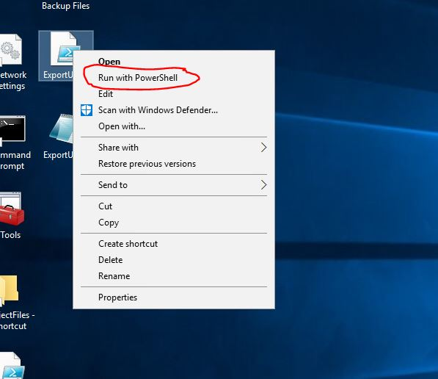
THE POWERSHELL SCRIPT FOR EXPORTING USERS OUT OF AD
Right click on the script and select Run with PowerShell to execute the script as shown below.

Slide 36
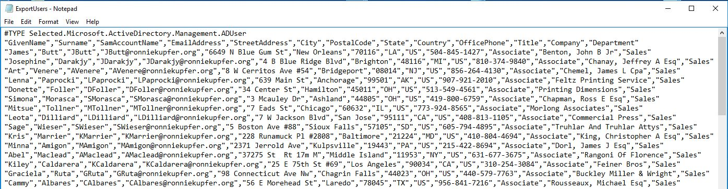
THE POWERSHELL SCRIPT FOR EXPORTING USERS OUT OF AD
The exported .CSV file looks like the following.

Slide 37
THE POWERSHELL SCRIPT FOR EXPORTING USERS OUT OF AD
Two videos showing the bulk uploading of AD users, assigning a login script to the users, and exporting users out of AD can be watched at the links below.
https://www.youtube.com/watch?v=_Dw3CtyTcbc
https://www.youtube.com/watch?v=M3F4l_A0Qac

Slide 38
Sources
https://networkproguide.com/powershell-export-active-directory-users-to-csv/
https://activedirectorypro.com/create-bulk-users-active-directory/
https://www.alitajran.com/create-active-directory-users-from-csv-with-powershell/

